Slide 1
ELECTROCHEMISTRY

Slide 2
Points to be discussed
Electrochemistry
Electric conductor
Electrolysis and Electrolytic cell
Mechanism of electrolytic cell
Electrochemical series
Application of electrolysis
Electroplating
Electrochemical cell
Voltaic cell
Difference between Electrolytic cell
and Electrochemical cell
Types of Battery
Cell potential

Slide 3
The branch of Physical Chemistry which deals with the relationship between electrical energy and chemical energy and their inter conversion
Electrochemistry

Slide 4
Electric conductor
Metallic conductor or electronic conductor
Electrolytic conductor
Metallic conductor
Metals pass electricity with the help of moving electrons
b. Electrolytic conductor
Conduct electric current either by aqueous solutions or
in the molten state

Slide 5
Types of Electrolytic Conductor
Electrolytic conductor
Strong electrolyte
e. g.; Strong acid, strong alkali
Weak electrolyte
e. g.; weak acid, weak alkali

Slide 6
Electrolysis
The process of chemical decomposition of an
electrolyte in the molten state or in an aqueous
solution by passing electric current through
it is called electrolysis.
In electrolysis, electrical energy is convert
in to chemical energy.

Slide 7
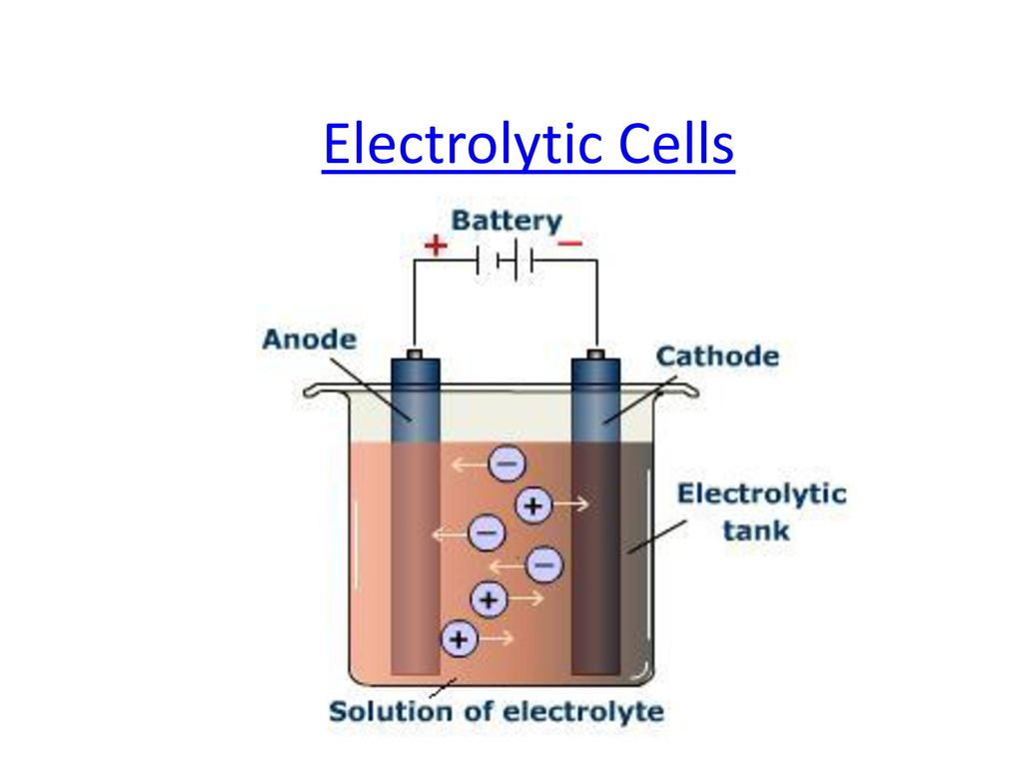
Electrolytic Cells
An electrolytic cell is an electrochemical cell that drives a non-spontaneous redox reaction in the presence of electric current supplied by an external source.
They are often used to electrolysis process.

Slide 8
Terms in electrolysis
Electrode is a rod of metal or graphite through which an electric current flows into or out of an electrolytic solution
Anode is the positive electrode of an electrolytic cell
Anion is a negatively charged ion which is attracted to the anode
Cathode is the negative electrode of an electrolytic cell
Cation is a positively charged ion which is attracted to the cathode

Slide 9
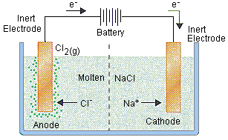

Mechanism of electrolysis
Anode reaction
Cathode reaction

Slide 10
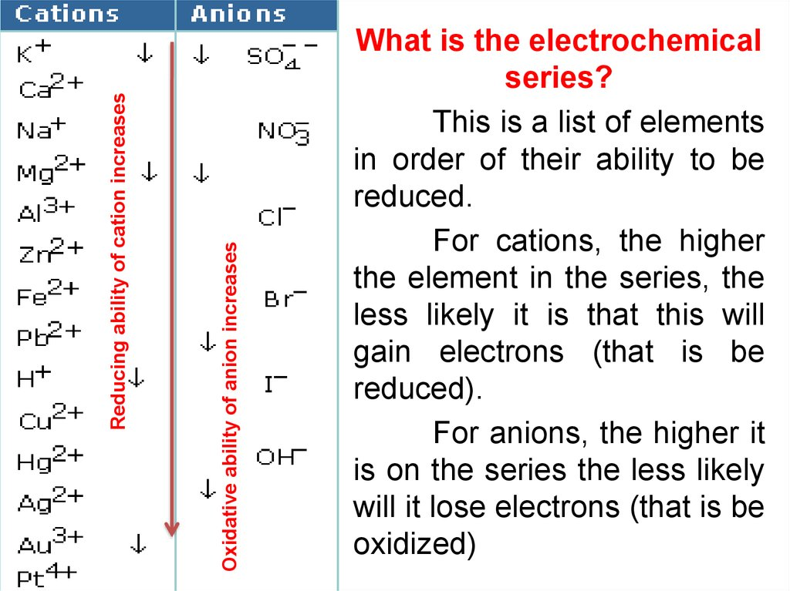
Electrochemical series

Slide 11
Application of Electrolysis
Electroplating
Extraction of metals
Purification of metals
Manufacture of chemicals

Slide 12
Principle of Electroplating
In electroplating, the anode is made up of the metal which we want to use to coat the surface of another metal.
A salt solution containing the metal that makes up the anode is used. During electrolysis, the anode metal is oxidized and goes into solution as positive ions.
These positive ions are then reduced on the surface of the cathode (the metal we are coating)

Slide 13
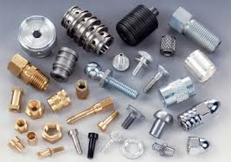
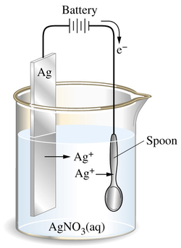

Electroplating
Fig.: Electroplating on a spoon

Slide 14
Electrochemical Cell (Battery)

Slide 15
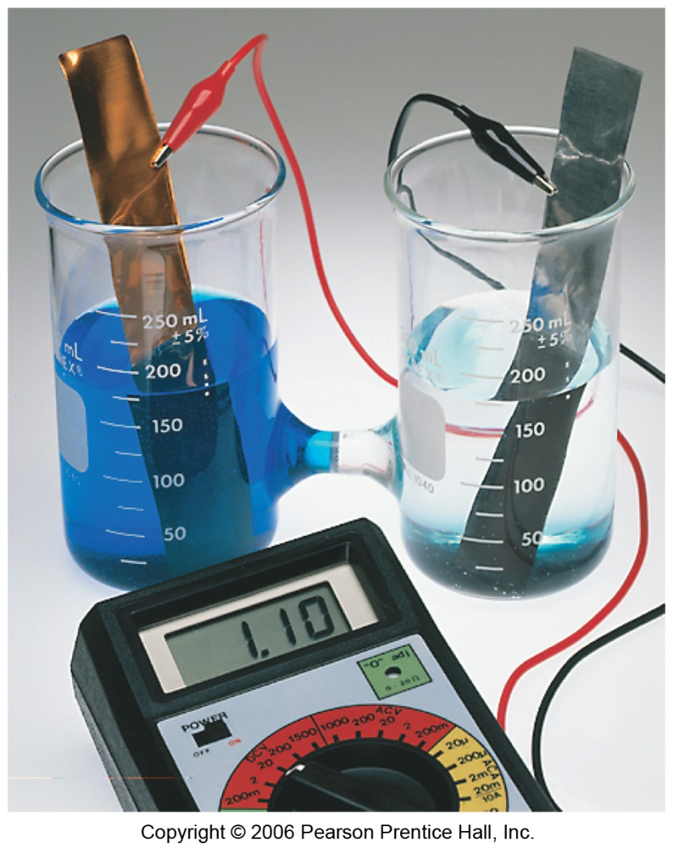
What is electrochemical cell?
An instrumental arrangement of current flow where chemical reaction results In the production of electric current.
We call such a setup :
Voltaic cell
Daniel cell
Battery
Electrochemical cell
Galvanic cell

Slide 16
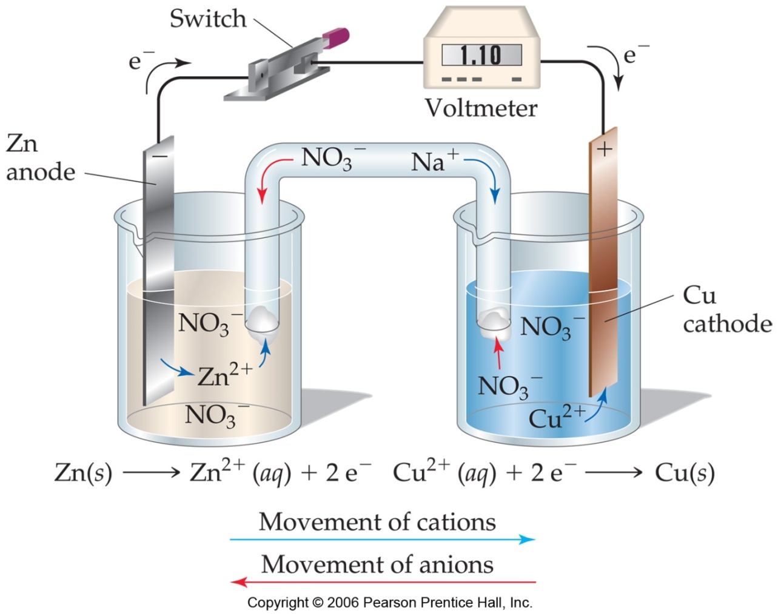
Typical Voltaic Cells
The oxidation occurs at the anode.
The reduction occurs at the cathode.
Electrons flow through the wire!

Slide 17
Difference between electrolytic cell and Electrochemical cell
1
Electrolytic cell
Electrochemical cell
Electricity is passed from
external source
Electricity is produced by
chemical reactions
2. Electrical energy is converted
in to chemical energy
2. chemical energy is converted
in to Electrical energy
3. Metal ions cause the flow
of electricity
3. Free electron cause the
flow of electricity
4. Anode is positively and
Cathode negatively charged
4. Anode is negatively and
Cathode positively charged
5. Redox reaction is
non-spontaneous
5. Redox reaction is
spontaneous

Slide 18
Types of Battery
They are two types of batteries-
Primary batteries
Secondary or storage batteries
Primary batteries
one continuous discharge,
cannot be reused and re-charged.
Use in flashlights.
A secondary or storage battery
change is reversible.
After the battery has discharged, it is brought
back to a charged state.
lead- (sulfuric) acid battery.

Slide 19
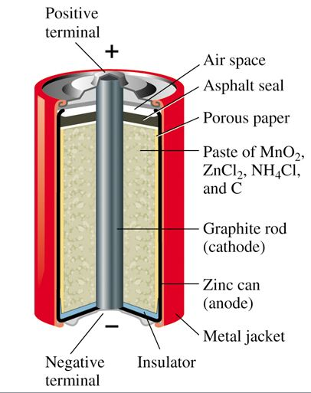
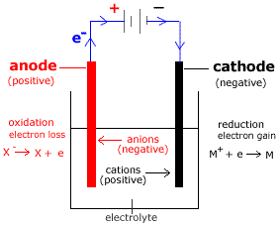
Primary Battery

Slide 20
Discharge reactions in a primary battery:
Anode: Zn → Zn²⁺ + 2e–
Cathode: 2NH₄⁺ + 2MnO₂ + 2e– → Mn₂O₃ + H₂O + 2NH₃
However, this is complicated by the fact that the ammonium ion produces 2 gaseous products:
2NH⁴⁺ + 2e– → 2NH₃ + H₂
These products must be absorbed in order to prevent build up of pressure in the vessel. This occurs by the mechanism:
ZnCl₂ + 2NH₃ → Zn(NH₃)₂Cl₂
2MnO₂ + H₂ → Mn₂O₃ + H₂O

Slide 21
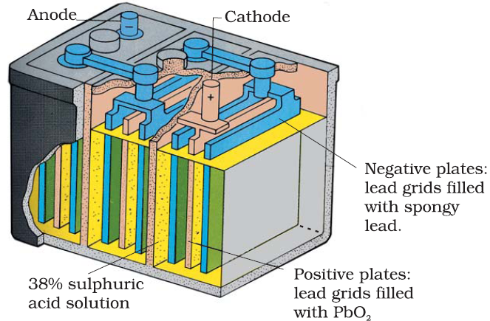
Secondary Battery

Slide 22
Discharge and charge reactions in a secondary battery:
Anode (Oxidation):
Pb (s) + H₂SO₄ (aq) → PbSO₄ (s) + 2e⁻ + 2H⁺ (aq)
Cathode (Reduction):
PbO₂ (s) + 2H⁺ + H₂SO₄ (aq) + 2e⁻ → PbSO₄ (s) + 2H₂O (l)
Overall Reaction:
→ (discharging)
PbO₂ (s) + Pb (s) + 2H₂SO₄ (aq) = 2PbSO₄ (s) + 2H₂O (l)
← (charging)
Repeated charging causes hydrolysis of H₂O into H₂ and O₂, so distilled water is added.

Slide 23

Cell Potentials
E_{an} = +0.76 V
E_{cat} = +0.34 V
E_{cell}= +0.34 V +0.76 V
= +1.10 V

Slide 24
Thank you very much for your time

